Slide 1

Demonstration of Utility Managed Smart Charging for Multiple Benefit Streams
For Argonne-Exelon Biweekly
Argonne National Laboratory
February 3rd, 2022

Slide 2
BP2 Study Scope and Tasks
Simulate the impact of EV charging on the grid. Design innovative tactics that will maximize the customer participation, flexible resource availability, and grid benefits. Market programs to customers, enroll them in smart charging program. Install utility-owned charging network.
Use the ATEAM tool to simulate the impact of EV charging on the grid (Argonne)
Execute customer engagement program by connecting with customers
Install a utility-owned charging network
Supply and install (as needed) smart EVSE or smart managed-charging devices to customers
Enroll customers in the Smart Charge Management demonstration
Collect data and develop system settings that will inform the economic impact (cost and benefit) analysis on EVSEs and the grid (Argonne)
Perform a grid cybersecurity impact analysis considering large scale distribution system with EV penetration (Argonne)

Slide 3
Argonne research tasks
Simulate the impact of EV charging on the grid, quantify the cost and benefits, identify the cyber-physical threat
Simulate the impact of EV charging on the grid
Expand utility-agent decision-making and resulting driver-agent response in charging
Incorporate incentives for smart charging
Develop ATEAM-T&D co-simulation platform
Quantify impacts to distribution and transmission systems from power quality point of view
Collect data and develop system settings that will inform the economic impact (cost and benefit) analysis on EVSEs and the grid
Estimate levelized cost of charging for EVSE provider ($/kwh)
Assess the grid upgrade needs, and resulting cost and benefits
Perform a grid cybersecurity impact analysis considering large scale distribution system with EV penetration
Identify cyber-physical threats, develop threat models and perform cyber impact analysis of EV integrated power system using T&D co-simulation platform.

Slide 4
Interactions between ANL Models
Cyber Threat Models
ATD
Grid Impact
ATEAM
TDcoSim
Cybersecurity Impact
A-LEAF
Economic Impact
ATEAM
Agent-based Transportation Energy Analysis Model
TDcoSim
Transmission, and Distribution (T&D) co-simulation tool
ATD
ATEAM + T&D co-simulation platform
A-LEAF
Argonne’s Low-Carbon Electricity Analysis Framework

Slide 5

ATEAM simulates the co-Evolution of EV adoption and charging deployment
INPUTS
Vehicle registrations
Vehicle efficiency
Census tract characteristics
Household characteristics
EV projections *
Chargers by type
Travel demand
Charging behavior
Charging loads
Unmet demand
Charger utilization
EV Battery state of charge
Locations of new chargers
Etcetera
THE A-TEAM
* Currently input; can be output upon full implementation
OUTPUTS

Slide 6
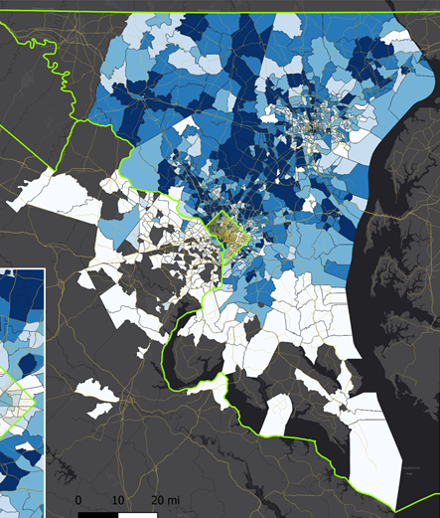
Develop ATEAM-T&D (ATD) co-simulation platform
Objective: Evaluate the Impact to Grid with Large-Scale EV Charging Load
Develop ATEAM-T&D (ATD) co-simulation platform
Generate operation scenarios
Hourly charging load from ATEAM TDcoSim platform
Hourly loading profile of the grid
Perform simulation study and write report
Conduct Impacts Analysis
Identify the weakness of existing grid
Explore the potential solutions
Outputs
Voltage and line flow information including violations
Customers not served, if any. Different metrics such as number of customers affected, MWh lost.
Boundary condition at T&D interface (voltage and power)
Notes:
Over-voltage and under-voltage (in % of nominal voltage)
Over-load (in % of affordable loading)
Power line over-flow (in % of line rating)
Mitigation strategies for above (stretch goal, based on two-way information flow)
Long-term Grid Reliability:
N-1 contingency analysis and corresponding risk analysis of EV nodes/buses (in % of potential overflow during N-1 contingency analysis)
Risk of extreme event estimation (in probability of EV-charging caused grid damages, and loss of EV loads)

Slide 7
T&D (ATD)
One way information flow from ATEAM to T&D co-simulation
Can evaluate the impact of EV on grid
Issues can be identified but not addressed
Bidirectional information flow between ATEAM and T&D co-simulation (stretch goal)
Can evaluate and mitigate
Issues can be identified and addressed to the extent possible

Slide 8
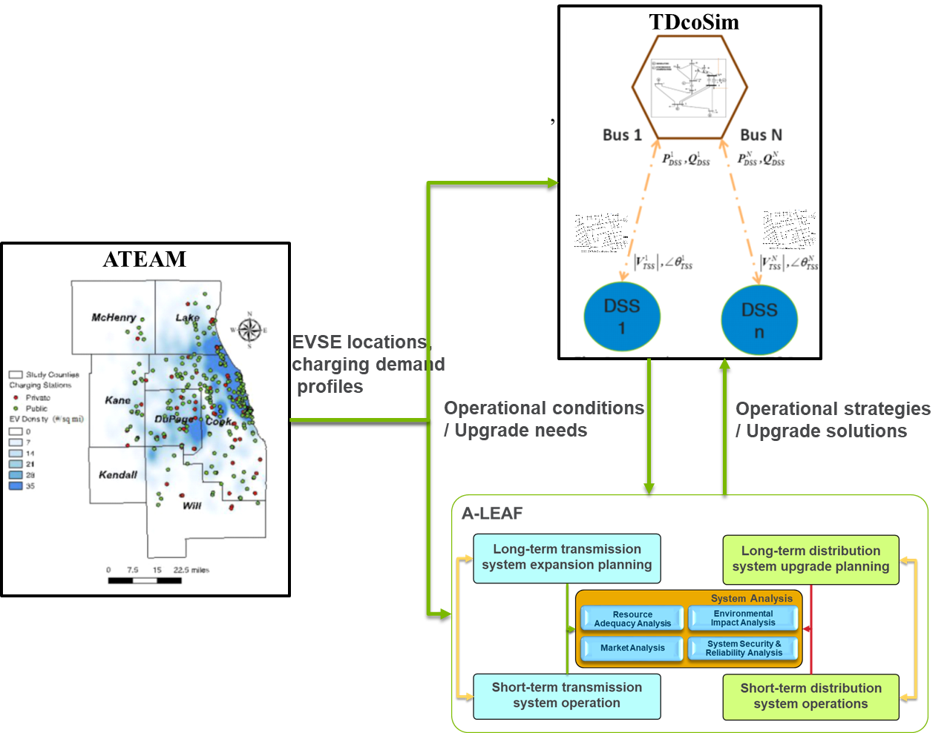
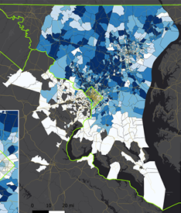
Economic impact analysis on EVSE and the grid
Objective: Quantify the cost and benefit for EVSE provider and the grid
Develop distribution system model: aligned with ATEAM-T&D (ATD) co-simulation platform
Evaluate grid expansion scenarios: to accommodate EV penetration and EVSE expansion needs identified by the ATEAM and TDcoSim models
Conduct economic analysis to access the potential of achieving multiple benefit streams
Outputs
Levelized cost of charging for EVSE providers
Evaluate the levelized cost of charging with smart
charging scenarios ($/kwh or $/day/plug can be aggregated numbers or by types))
Include unconstrained charging, smart charging
management, and/or grid service provision.
Levelized cost for Utilities
Identify grid upgrade needs and resulting
costs and benefits for a given scenarios ($/kw-year).

Slide 9

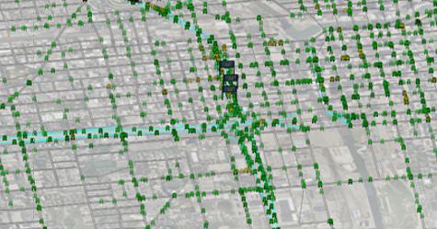

Argonne’s Low-Carbon Electricity Analysis Framework (A-LEAF)
Long-term Expansion Planning
Transmission System
Distribution System
Upgrade Planning
Generation Expansion Planning
Transmission/Distribution System Expansion Planning
Hosting Capacity Analysis
Transportation/Traffic Input Modeling
Forecast scenarios:
Load Forecast
VRE Output Forecast
Policy Environment
System Analysis
Resource Adequacy Analysis
Environmental Impact Analysis
Market/Economic Analysis
System Security & Reliability Analysis
PEV Charging Profile
PEV Modeling
Short-Term Operational Planning
Charging/Fueling Behavior
Transmission System
Distribution System
Time use / activities
/ SoC per PEV
Day-Ahead Security Constrained Unit Commitment
Intra-day Security Constrained Unit Commitment
Power Flow Analysis
Spatio-Temporal Aggregation
Charging Station
GIS information
Contingency Analysis
Real-Time Security Constrained Unit Commitment
Economic Operation
A-LEAF

Slide 10
Cyber
Objective: Assess the impact of cyber-attack on the steady-state and dynamic performance of EV integrated power grid under various threat scenarios.
Analysis
Perform architecture analysis of power systems including communication, control, and field devices.
Utilize the vulnerabilities and actors identified in Year 1 to develop the treat models (Key scenarios: Data manipulation, denial of service (DoS) attack, the man in the middle attack, and device misconfiguration)
Outputs/metrics/results
Cyber threat models
Attack scenarios
Impact analysis results. The key metrics would be voltage and frequency deviations, stability margins, line loadings, customer not served, customer interruption time, etc.

Slide 11
Key Cyber Projects

Slide 12


Next-generation Attack-resilient Electricity distribution systems
Objective
To develop a multi-layer attack-resilient holistic approach with particular focus on architectural changes of current electricity distribution systems and the needed innovation on DMS cybersecurity with increasing penetration of DERs and microgrids
Motivation
Increasing penetration of DERs, microgrids, and other smart grid technologies significantly enlarge the attack surface
Existing DMS and other systems are lacking protection from cyber attacks
Attack Surface for DMS of Next-Generation Distribution Systems
Key Activities
Develop system architecture for next-generation distribution systems
Identify key DMS applications and actors for cyber security analysis
Identify cyber, physical, and functional links for various actors
Develop attack tree models for key DMS applications
Cyber, Physical, and Functional Connectivity Identification for Various Actors

Slide 13
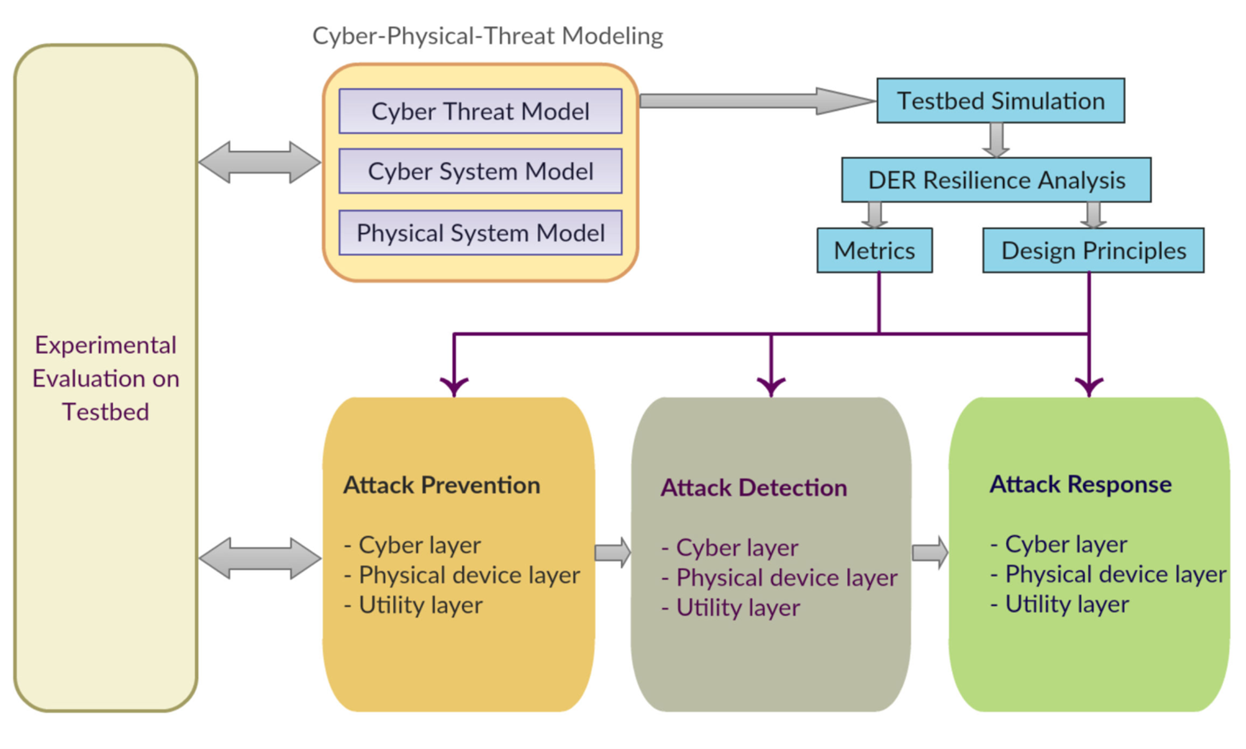
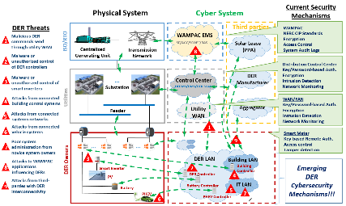



Cybersecurity for renewables, distributed energy resources, and smart inverters
Objective
To develop a holistic attack-resilient architecture and layered cyber-physical solution portfolio to protect the critical power grid infrastructure and the integrated distributed energy resources (DER) from malicious cyber attacks.
Key Activities
Develop DER cybersecurity framework, architecture, threat models, attack prevention, detection and mitigation strategies followed by R&D experimentation and technology transfer for cyber-physical power system at cyber, device and utility layers.
Attack-Resilient Framework for DER cybersecurity
Accomplishments
Developed machine learning based DER attack detection strategy and a bi-level attack mitigation strategy using energy buffer for smart inverters.
Developed a co-simulation platform, integrating OpenDSS and a IEEE 2030.5 protocol library, to evaluate the detection algorithms by simulate cyber attacks against DER communications.
A prototype of smart inverter TTE to enable the increased security in communications with the inverter.
Emerging DER Architecture and Cyber Attacks

Slide 14
Thank you!

